Slide 1
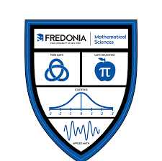

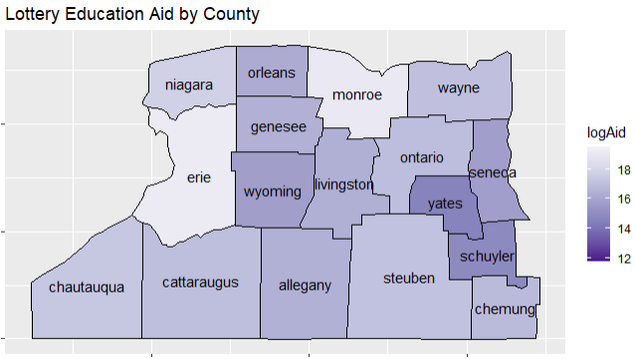
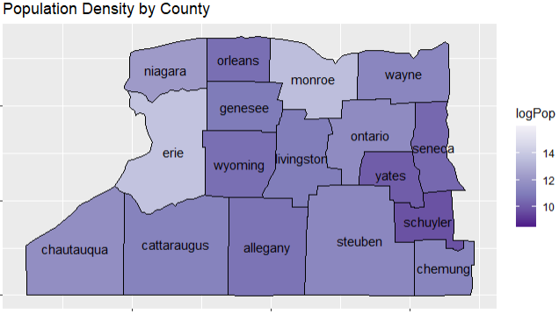
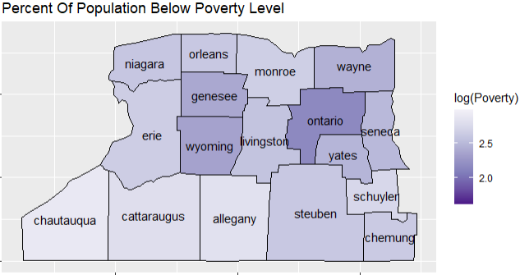
New York State Lottery
Funding Towards Education
By Jay Casey
State University of New York at Fredonia, Mentor: Dr. Amber Powell
Abstract
Methodology
Maps
Conclusion
This project is about checking if the lottery education funding in New York state is fair based on the county population size and poverty rates. In New York, lottery funding is used a lot for education programs, but people are wondering if it's fair or not. This project aims to see if the lottery money given to counties in New York is different depending on the population and poverty rates. Data was gathered on lottery education funding, county populations, and poverty percentages from different counties in Western New York and analyzed with correlation testing. These results will be useful in figuring out if the lottery system in New York is fair or not and help with giving education resources in a more balanced manner.
Data Gathered from NYS Lottery, Federal Reserve Economic Data, and NY Demographics
Data Manipulated using Excel Queries and R-Studio
Created Choropleth plot to show the density by county of explanatory variables
Conducted Logarithm transformations to improve testing conditions
Conducted correlation testing on Population and Poverty with Lottery as a response
Lottery funding per county is determined solely by population. Based on the correlation testing results, Percentage of Poverty is not highly correlated with Lottery aid. This shows that the lottery prioritizes funding schools in areas with a larger population over areas that have a higher poverty rate.
Future Work and Limitations
Figure 1: Choropleth Graph of Lottery Education Aid by County in Western New York
For the model, the data used was limited to the Western New York region in 2019. This was done because the data provided by the NYS Lottery chose to combine the counties within NYC into one large category, and 2019 was the most recent school year before the COVID-19 pandemic. This threw off the scaling and created a large problem within my testing. If given more time, this project could use the entirety of New York to make a more inclusive demonstration of how the funds are being distributed, as well as make a time series to include multiple years. Beyond statistical analysis, this project could propose a new method of distributing the funds that consider poverty rates and population in a more effective way.
Results
The statistical analysis found that Lottery Aid and Population are highly positively correlated, while Lottery Aid and Poverty were not correlated. This result was supported by correlation testing and visually demonstrated in Figure 1 and Figure 2.
It is important to note that the conditions for correlation were not entirely satisfied, but there were no issues of multicollinearity between the explanatory variables.
Overall, these findings suggest that Lottery Aid may be more effective in targeting areas with high population densities rather than areas with high poverty rates.
Comparing Figures 1 and 2 shows a strong correlation between Lottery Aid and Population, while comparing Figure 1 and 3 indicates no clear relationship between Lottery Aid and Poverty Percent.
Introduction
A major headline for the New York lottery is their contributions toward the public school system. While many think this is a blessing, it is unclear how accurate the funds are being distributed among the many school districts that exist in the state. The New York Lottery website states, “It takes into account both a school district's size and its income level.” However, there is no laid- out formula that its disbursement seems to follow. This project is going to take a deep dive into the factors listed on the lottery’s website with a focus on counties in the Western New York region, and test just how correlated they are.
Figure 2: Choropleth Graph of Population Density by County in Western New York
Acknowledgements
Thank you Dr. Amber Powell for your continued support and guidance throughout this project and my academic career. Data was provided by NYS lottery, Federal Reserve Economic Data, and NY Demographics via their websites.
Figure 3: Choropleth Graph of the Percentage of Poverty within Counties of Western New York

